Slide 1
Predicting athletes performances and game winners- NBA
Vuk
Boskovic

Slide 2

Predicting NBA player performance
The NBA is particularly well suited for machine learning applications because the performance of NBA players across different positions can be measured using the same set of statistics, which is not the case with some other sports.

Slide 3
Furthermore, applying machine learning algorithms to predict the performance of individual athletes also has a natural extension in predicting the outcomes of games.

Slide 4
Feature Selection
The ability to accurately predict the performance of NBA players depends upon determining and using features that are strongly correlated with the number of points an NBA player will score against any given opponent.

Slide 5
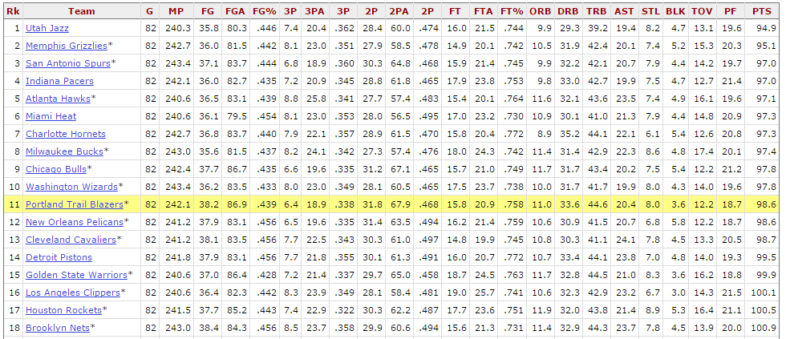

Slide 6
Team rating
Made Defensive team rating – how much points does team allow to opponents per game
Later improved to get better results

Slide 7
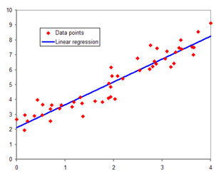
Linear regression
Linear regression is used to predict the number of points each player would score against a particular opponent.

Slide 8
Results 1
Overall, using first type of team defensive rating, the linear regression model was able to predict a player’s points with an average error of 24%.

Slide 9
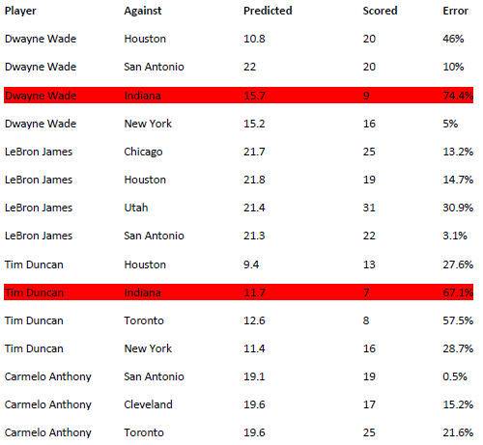
Results 1

Slide 10
Results 2
Used different approach to improve results
Changed defensive team ranking – rank first then get their current position

Slide 11
Results 2
This approach gave better results
An average error of this approach is 20% which is 4% less then first

Slide 12
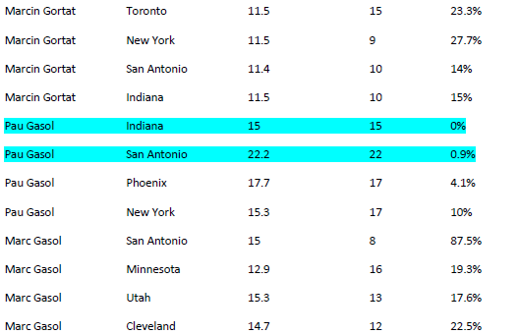
Results 2

Slide 13
Some players like Marc and Pau Gasol do not have big deviations and their performances are predicted with small errors on the other side Tim Duncan have big so predictions for his performances are not so good.

Slide 14
The inability to accurately predict the deviations in a player’s PPG was most likely because of the inability to accurately model player-level statistics.
The challenge in predicting these statistics lies in difficulty to quantify and considering all necessary factors.
(player’s level of confidence, who is his coach, how often he plays…)

Slide 15
Predicting game winners
Extended project to see how it influences on game outcomes (Win/Lose) by implementing Naive Bayes model.

Slide 16

Naive Bayes
Probabilities of independent events

Slide 17
Considering performances of 3 “most influencing” players on the game outcome.
Gave different results depending on their teams performances.

Slide 18
Results
Got a results with 73% successful predictions.
Better and worse teams in league gave better results then average
Golden State Warriors 93.1% - (73-9)
Utah Jazz 58.6% - (40-42)
Miami Heat 68.9% - (48-34)
New Orleans Pelicans 75.8% - (30-52)

Slide 19
Future
One strategy is to attempt to classify the confidence level of a player (which may influence how well he plays) by weighting his recent performances more than his earlier performances.

